Slide 1


Slide 3


Slide 4

Setup is starting…

Slide 5


Slide 6
BlueOS

Slide 7
BlueOS
Install Now
Repair PC
©️2024 Blue Computers Inc.

Slide 8
Welcome to BlueOS.
Thank you for choosing BlueOS, the newest and greatest operating system that is way better than any other operating system. This setup wizard will help you install this on your brand new computer. Please click next to continue the setup.
Next

Slide 9
Select your edition of BlueOS
The Home edition of BlueOS is completely free to use, however if you want to use the Pro Version, it costs $123 per computer. To see more information go to https://blueos.bluecomputers.rn/pro/price.
Name | Architecture | Edition | Price
BlueOS Home | x32 | Home | $0.00
BlueOS Home | x64 | Home | $0.00
BlueOS Arm | ARM | Arm | $0.00
BlueOS Pro | x32 | Pro | $123.21
BlueOS Pro | x64 | Pro | $123.21
Next

Slide 10
Please accept the license agreement
To use BlueOS, you have to accept the license agreement, otherwise you cannot use the operating system, and will have to go out and buy Microsoft Windows, or any other operating system.
BLUE OS LICENSE AGREEMENT This is not a real operating system, it is just a OS Concept created by 7Zeb (https://www.youtube.com/@7zeb) Project started on: July 21, 2024 All Branding belongs to me (7Zeb), and me only, because I made this OS Concept. Discord: https://discord.gg/Bt5ftypZK7
Accept

Slide 11




Where do you want to install BlueOS
Please select a place to install BlueOS.
Name | Drive Type | Size | Free Space
Disk 0 | M.2 SSD | 512 GB | 512GB

Slide 12
Where do you want to install BlueOS
Please select a place to install BlueOS.
Name | Drive Type | Size | Free Space
Disk 0 | M.2 SSD | 512 GB | 512GB
Next

Slide 13
Select the type of installation.
Please select the type of installation you want to do. You can choose from Compact, Portable, Full, or custom. Compact and Portable are meant for computers with not so good hardware.
Name | Type | Space Required
BLCO | Compact | 700 MB
BLP | Portable | 1.8 GB
BLF | Full | 5.7 GB
BLC | Custom | 700 MB – 5.7 GB

Slide 14
Select the type of installation.
Please select the type of installation you want to do. You can choose from Compact, Portable, Full, or custom. Compact and Portable are meant for computers with not so good hardware.
Name | Type | Space Required
BLCO | Compact | 700 MB
BLP | Portable | 1.8 GB
BLF | Full | 5.7 GB
BLC | Custom | 700 MB – 5.7 GB
Next

Slide 15
Getting Ready to Install
Please verify you want to install with these settings, then click Next.
Edition: Home x64 Disk: Disk 0 Installation Type: BLF (Full Install) GO BACK!
Next

Slide 16
Installing BlueOS
Sit back and relax as BlueOS installs.
Estamated Time Remaining: 1 Minute

Slide 17
Installing BlueOS
Sit back and relax as BlueOS installs.
Estamated Time Remaining: 1 Minute

Slide 18
Installing BlueOS
Sit back and relax as BlueOS installs.
Estamated Time Remaining: 1 Minute

Slide 19
Installing BlueOS
Sit back and relax as BlueOS installs.
Estamated Time Remaining: Less than a Minute

Slide 20
Installing BlueOS
Sit back and relax as BlueOS installs.
Estamated Time Remaining: Less than a Minute

Slide 21
Installing BlueOS
Sit back and relax as BlueOS installs.
Estamated Time Remaining: Less than a Minute

Slide 22
Installing BlueOS
Sit back and relax as BlueOS installs.
Estamated Time Remaining: Less than a Minute

Slide 23
Installing BlueOS
Sit back and relax as BlueOS installs.
Estamated Time Remaining: Less than a Minute

Slide 24
Installing BlueOS
Sit back and relax as BlueOS installs.
Estamated Time Remaining: Less than a Minute

Slide 25
Your computer needs to restart
Please click on Restart to restart your computer.
Restart
Restart

Slide 29
Getting Ready...

Slide 30
OOBE is starting

Slide 31
Welcome to BlueOS
This is the OOBE, where you connect to the internet, setup your account, and more.
Next

Slide 32






What country are you in?
Please select your country, then click next.
Search
United States
France
Italy
Canada

Slide 33
What country are you in?
Please select your country, then click next.
Search
United States
France
Italy
Canada
Next

Slide 34

Connect to the internet
Please connect to the internet, or click "I don't have internet."
Search
No networks found
I don't have internet
Next

Slide 35
Are you sure?
Connect to the internet to get the full experience.
Yes Continue
Go back

Slide 36

Create your user account
Make a username for your user account.
Go back
Next

Slide 37
Create your user account
Make a username for your user account.
7Zeb
Go back
Next

Slide 38
Create your user account
Make a password for your user account.
Go back
Next

Slide 39
Create your user account
Make a password for your user account.
******
Go back
Next

Slide 40
Your ready
You are ready to use BlueOS, restart the computer to get to the login screen.
Restart

Slide 43
Log In
Please login to BlueOS
7Zeb

Slide 44
Log In
Please login to BlueOS
7Zeb
******
Login

Slide 45





Trash
BlueWeb
4:22PM - CT 10/4/2024 - Friday

Slide 46

Trash
BlueWeb
Blue Computer
BlueWeb 6
Connecting to the internet...
4:22PM - CT 10/4/2024 - Friday

Slide 47
Trash
BlueWeb
Blue Computer
BlueWeb 6
Your device is not connected to the internet.
4:22PM - CT 10/4/2024 - Friday

Slide 48


Trash
Start
BlueWeb
All Apps
There’s nothing here yet, open some programs for stuff to show up here.
4:23PM - CT 10/4/2024 - Friday

Slide 49

Trash
BlueWeb
BlueOS
Settings
Loading...
4:23PM - CT 10/4/2024 - Friday

Slide 50










Settings
Trash
Try “Display”
System
BlueWeb
System
Display
Network & Internet
Sound
Personalization
Battery
Accounts
Storage
Accessibility
Update
4:23PM - CT 10/4/2024 - Friday

Slide 51




Settings
Trash
Try “Display”
Network & Internet
BlueWeb
System
Wi-Fi
Network & Internet
VPN
Personalization
Dial up
Accounts
Ethernet
Accessibility
Update
4:23PM - CT 10/4/2024 - Friday

Slide 52

Settings
Trash
Try “Display”
Wi-Fi
BlueWeb
System
Fix
You're not connected to any networks
Network & Internet
Personalization
Connect to the internet to browse the
Accounts
Accessibility
Update
4:23PM - CT 10/4/2024 - Friday

Slide 53
Settings
Trash
Connect to Wi-Fi
Wi-Fi
Try “Display”
BlueWeb
Connect to a Wi-Fi network to browse the web or download apps.
System
Fix
RutwikStuffCorp.
You're not connected to any networks
Network & Internet
RutwikStuffGuest.
Personalization
Connect to the internet to browse the
Accounts
RS23 5Ghz
Accessibility
Update
4:23PM - CT 10/4/2024 - Friday

Slide 54


Settings
Trash
Try “Display”
Wi-Fi
BlueWeb
System
Disconnect
Your connected to the internet
Network & Internet
RutwikStuffGuest. Is connected. 3 MB Data Used in the last 30 days.
Personalization
Accounts
Accessibility
Update
4:23PM - CT 10/4/2024 - Friday

Slide 55
Trash
BlueWeb
4:24PM - CT 10/4/2024 - Friday

Slide 56
Trash
BlueWeb
Blue Computer
BlueWeb 6
Connecting to the internet...
4:24PM - CT 10/4/2024 - Friday

Slide 57
Trash
BlueWeb
Blue Computer
BlueWeb 6
Loading BlueWeb…
4:24PM - CT 10/4/2024 - Friday

Slide 58



Trash
BlueWeb
4:24PM - CT 10/4/2024 - Friday

Slide 59
https://7zeb.neocities.org
Trash
BlueWeb
4:24PM - CT 10/4/2024 - Friday

Slide 60
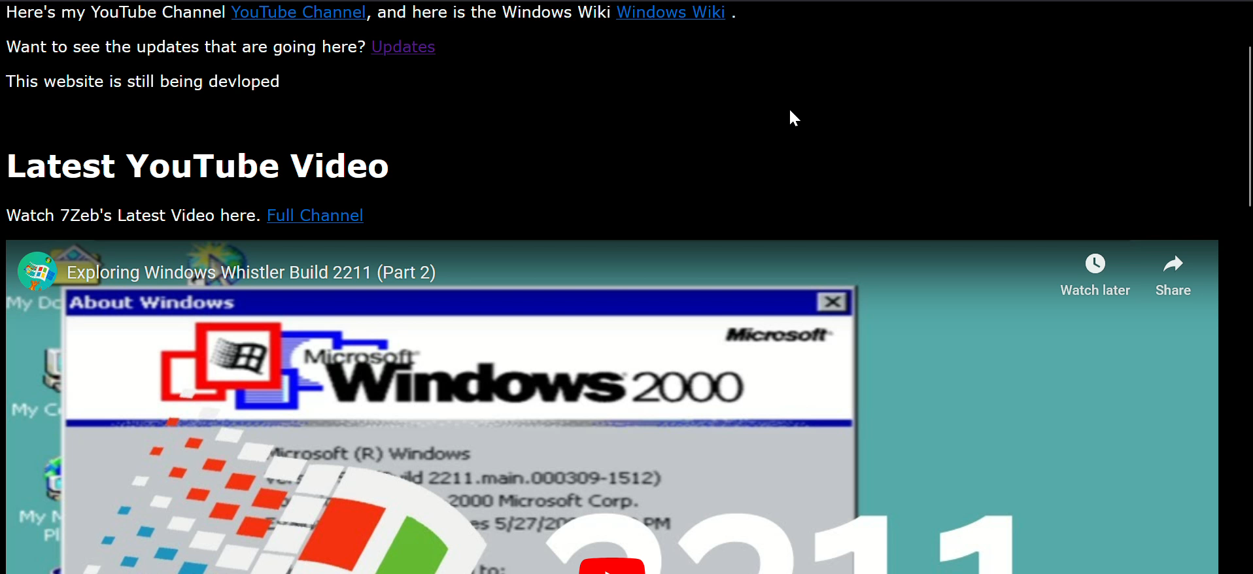
https://7zeb.neocities.org
Trash
BlueWeb
4:24PM - CT 10/4/2024 - Friday

Slide 61
Trash
Start
Try “BlueWeb”
BlueWeb
All Apps
There’s nothing here yet, open some programs for stuff to show up here.
4:23PM - CT 10/4/2024 - Friday

Slide 62
Trash
Start
about
BlueWeb
All Apps
There’s nothing here yet, open some programs for stuff to show up here.
4:23PM - CT 10/4/2024 - Friday

Slide 63
Trash
Start
about
BlueWeb
All Apps
about.exe
4:23PM - CT 10/4/2024 - Friday

Slide 64
Trash
BlueWeb
BlueOS
Build 309.2 (RTM), OS concept created by 7Zeb Registered to:
7Zeb
OK
4:23PM - CT 10/4/2024 - Friday

Slide 65

Shutting down
BlueOS is shutting down.

